Slide 1

NDMA CUAS Operators
VMS – Basic Operation

Slide 2
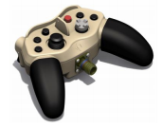
Basic System Operation
START UP
Following power on, the control PC automatically starts up and displays the VMS, CMS and Skyperion Control Station (If Dongle is attached)
CONTROLLING THE SYSTEM
VMS can be controlled using the following methods:
The Hand controller - can manually control EOD, and camera control.
Via the CMS – When mode is selected to do so in CMS
Standard Keyboard mouse – can control on screen buttons

Slide 3
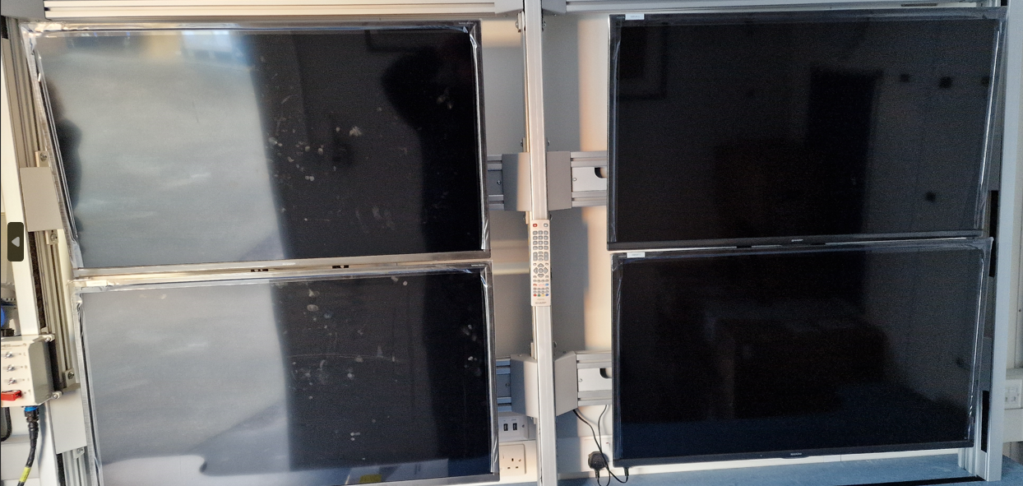
Basic System Operation
The following displays are provided to control and analyse the system:
These are setup as follows
Display 1: Chess CMS System
Display 1
Display 3
Display 2: Chess VMS System
Display 4
Display 3: Skyperion Control Station(SCS)
Can also be used to attach external device
Display 2
Display 4: Spare Display
Can also be used to attach external device

Slide 4
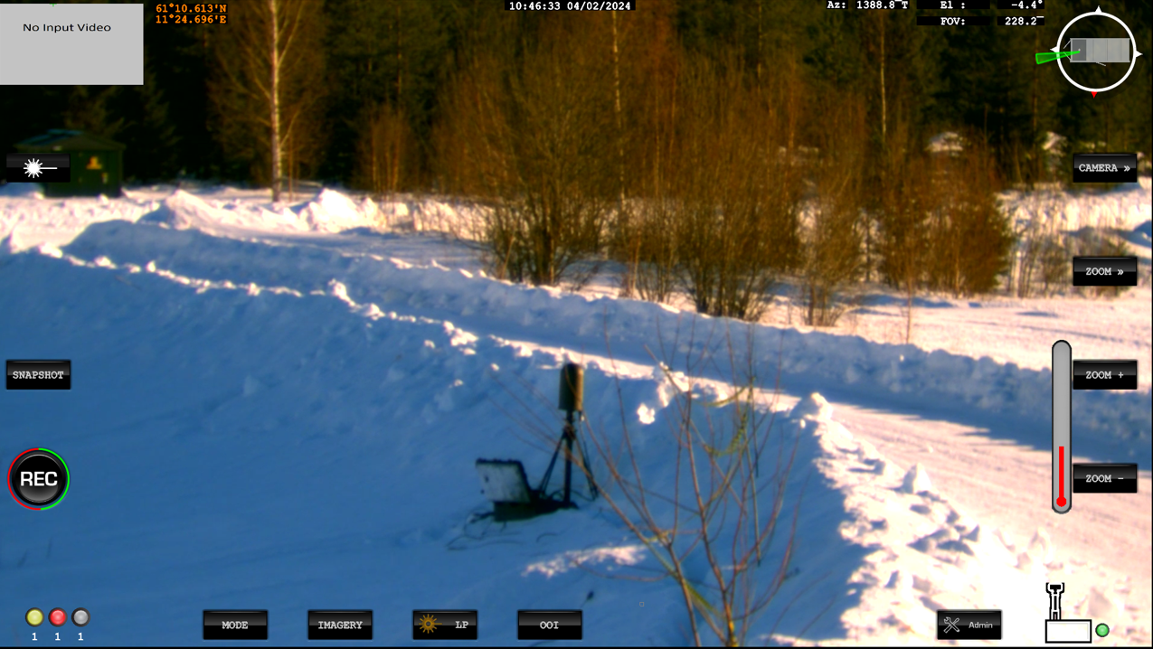
Basic System Operation - Main Display Navigation
Notes:
Top Middle: Date and Time – This is Zulu time (Not Norweigen)
Top Right: Current system AZ and EL angles including Active Camera FOV in Mils
Top Right: Compass / View of Camera direction in relation to the Container
Right: Control Selection
Right: Control Selection – Sub menu.
Right: Sub Menu controls.
Bottom right: Access to Admin Menu
Bottom: Modes, Imager, Laser Pointer and OOI (Objects of interest)
Mid Left: Video Recording and Image snapshot controls.
Very top left: Secondary Sensor Display. Selectable via Touch screen, F1 function Key
Top Left in Green: Lat/Long of the vehicle

Slide 5
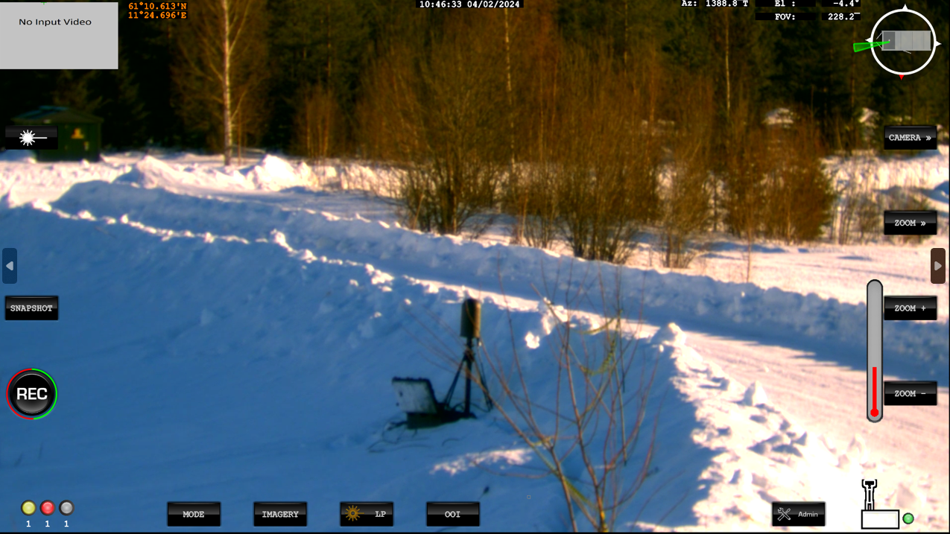
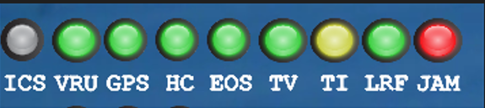
Basic System Operation - Sub-system indicators
The indicators in the bottom left of the main screen, show the status of the following sub systems:
Indicator | Description
ICS | Not Utilised on CUAS
VRU | Vertical Reference Unit (IMU)
GPS | Global Positioning Service
HC | Hand controller
EOS | Electro Optical System
TV | Television Camera
TI | Thermal Imaging Camera
LRF | Laser Range Finder
JAM | RF Defeat (Jammer)
Status Colour | Status
RED | Non-operational/faulty
YELLOW | Preparing for operation/no communication
GREEN | Operational
GREY | Not available

Slide 6







Basic System Operation - Mode selection
The system has several modes selected by the buttons at the bottom of the screen. Buttons are highlighted when active.
Button | Mode | Description
 | Standby (STBY) | Commands the platform to standby with the brakes applied and the motors switched off. Press the button twice to power off the console.
 | Manual (MAN) | Releases the brakes and allows the EOD to be controlled.
 | Track (TRK) | Press once to enter manual (target acquisition) mode, during which the gamepad controller can be used to control the pointing angle of the EOD. Press again to select the tracking mode, which follows items selected by the user. This mode can be used with both TV and the TI cameras. The joystick can also be used to toggle between manual and track mode. Selects auto track mode where the EOD is controlled by the automatic video tracker.
Notes:
We will go into to further tracking control later in the course.

Slide 7



Basic System Operation - Mode selection
Button | Mode | Description
 | Park (PARK) | When pressed, the EOD is driven to its park position and put in standby mode. This is System 0 and not North Orientated
 | Gyro | This is disabled for CUAS and not selectable.
 | Jammer | This is used to access the Jammer control.
Notes:
Jammer control to be discussed Later in the slides.

Slide 8





Basic System Operation – TV Camera Controls
The buttons on the right-hand side of the screen are used to control the currently active sensor. The buttons will change according to the sensor selected.
Camera control button | Description
 | Zooms in (narrows the camera’s field of view)
 | Zooms out (widens the camera’s field of view)
 | Focuses on a far object
 | Focuses on a near object
 | Sets the Camera to Auto Focus

Slide 9

Basic System Operation – TV Camera Controls
The buttons on the right-hand side of the screen are used to control the currently active sensor. The buttons will change according to the sensor selected.
Camera control button | Description
 | Displays the camera image in Black and White using an IR cut filter.
Notes:
Night mode enhances the TV Camera for use at night, but does not give night vision or a Thermal image.

Slide 10
Basic System Operation – TI Camera Controls
The buttons on the right-hand side of the screen are used to control the currently active sensor. The buttons will change according to the sensor selected.
Camera control button | Description
 | Zooms in (narrows the camera’s field of view)
 | Zooms out (widens the camera’s field of view)
 | Focuses on a far object
 | Focuses on a near object
 | Sets the Camera to Auto Focus
Notes:
TI Controls are similar to the TV Camera with some additional options.

Slide 11








Basic System Operation – TI Camera Controls
Camera control button | Description
 | Performs a calibration of the Thermal Camera Image
 | Powers On/Off the Thermal Camera
 | Switches between White Hot and Black Hot Thermal camera images. A notification is shown for 5 Seconds when changed.
 | Allows adjustment of the Threshold parameters. This can be Incremented/Decremented/Auto
 | Allows adjustment of the Contrast of the image. This can be Incremented/Decremented/Auto
 | Allows adjustment of the Brightness of the image. This can be Incremented/Decremented/Auto
Notes:
Thermal Camera Power: Good practice to switch the TI off when not in use. It has an internal cooling engine that has a life span.

Slide 12
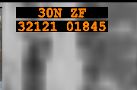
Basic System Operation - External Devices - GPS
Provides the following data:
  Container position
  This information is provided by a system GPS and compass
The units for displaying GPS position can be toggled between Latitude/Longitude, MGRS and UTM in the admin menu
Notes:
The GPS data is also used to calculate a target position when the laser is fired, using the vehicle position and the range returned by the laser. This is displayed in the top right of the main sensor display, as well as the top right of the full screen display.
Laser will be covered in a later module.
Admin Menus will be covered in a later module.

Slide 13
Software application
Questions?

